Slide 1
Modern Information Systems
Lecture – 03

Slide 2

Lecture 03
What is a business process.?
How business processes work
What are its components

Slide 3
Learning Outcomes
LO2: Evaluate the information systems strategies to achieve organizational goals

Slide 4
Session Objectives
At the end of this session, you will be able to;
Explain the evolution of Computing world.
Compare and contrast various modern Information Systems including Enterprise Systems.
Know what are real world examples for various modern IS.
Identify advanced technologies used in Modern IS.

Slide 5
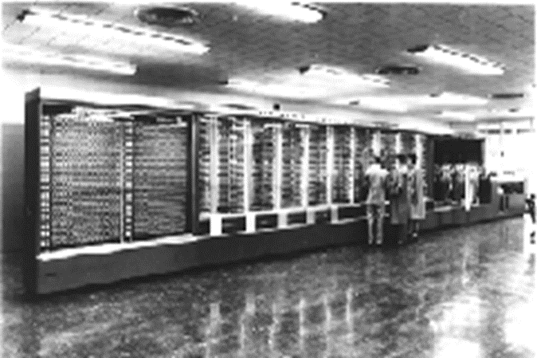
Evolution of Computing World
Early computers: Computing in 1945
Extremely difficult to use
Large & expensive
Used by specialists for scientific calculations etc.
Harvard Mark I
ASCC: IBM Automatic Sequence Controlled Calculator
55 feet long, 8 feet high, 5 tons

Slide 6
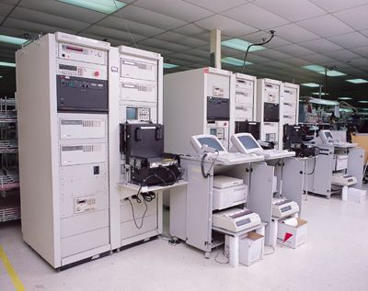
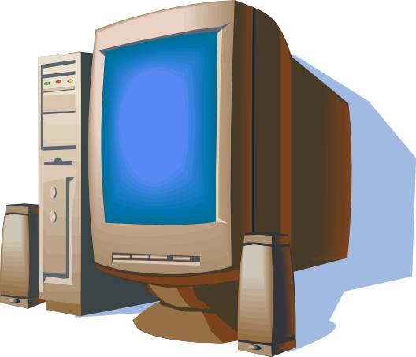
Computing Paradigms Cont.
Late 1950s - 1970s, Mainframe computers and dumb terminals
Batch processing
Time sharing
No graphical interfaces
In 1980s
Invention of a microprocessor
Development of PC’s - major landmark
Start using computers by people, customers
and end users of Business organizations

Slide 7
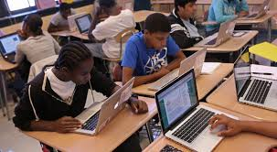
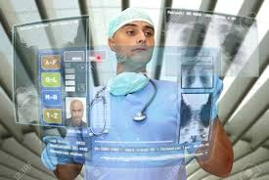
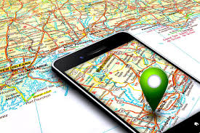
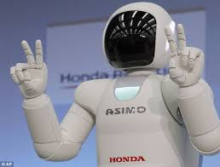
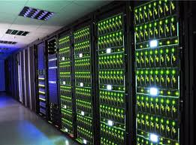
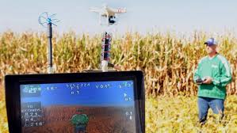
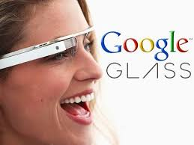
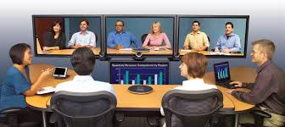

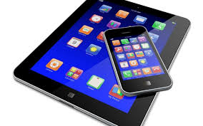
Computing Paradigms Cont.
Today (This era)

Slide 8
What made this change?
Advancement of technology
  Rapid advances in speed and capacity
Pervasiveness of Internet
  E-enabled world
Wireless, portable devices
  Any where, Any time work capability
Technology is configured into Information systems that help manage information to improve organizational performance.

Slide 9
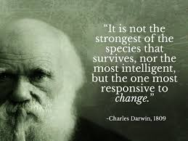
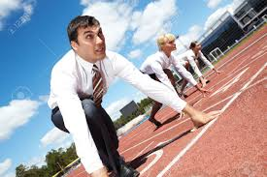
Key Idea:
Get ready to adopt to the modern world with modern Information Systems!!!!

Slide 10
Modern Information Systems
Office Automation Systems
Process Control Systems
Enterprise Systems
E-Commerce Systems
Decision Support Systems
IoT (Internet of Things) Systems
BI(Business Intelligence) Systems
Cloud based Systems

Slide 11
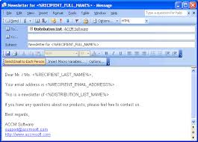
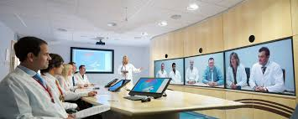

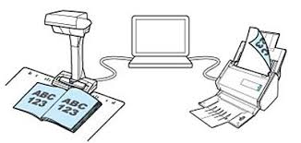
Office Automation Systems (OAS)
Used to manage the administrative functions in an office environment and are often critical to service-based industries.
OASs intended to increase the productivity of office workers.
Ex:
Groupware
Assists teams of people working together through facilities such as email and teleconferencing within or between companies
Document imaging process (DIP)
Converts documents into digital format using a scanner
which can then be stored, retrieved and manipulated
across a computer network.

Slide 12
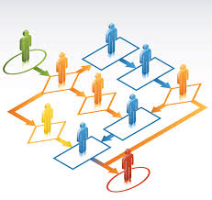
Office automation systems Cont.
Workflow management systems (WFMS)
Automate a business process by providing a structured framework to support the process as follows:-
Assign tasks to people.
Allow collaboration between people
sharing tasks.
Retrieve information needed to complete
a task e.g. customer details.
Provide an overview of the status of each task.
Used in conjunction with DIP to provide automated routing of documents.

Slide 13
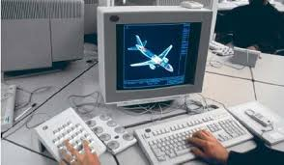
Process control systems
These systems support and control manufacturing processes.
Ex:
CAD/CAM (Computer Aided Design/Computer Aided Manufacturing)–
provides a graphics program which allows the design (CAD) and automated manufacture (CAM) of components.

Slide 14
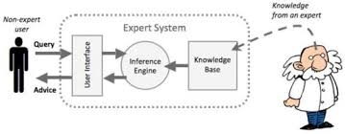
Expert systems
  Based on Artificial Intelligence technologies.
  Computer system that emulates the decision-making ability of a human expert.
  Represent the knowledge and decision-making skills of specialists.

Slide 15
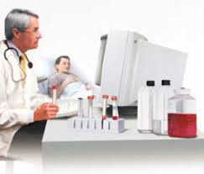
Expert systems Cont.
MYCIN: medical diagnosis
The first well known medical expert
system to help doctors, who are not
expert in antibiotic drugs. It prescribes such drugs for blood infections with the dosage adjusted for patient's body weight.

Slide 16

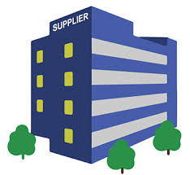

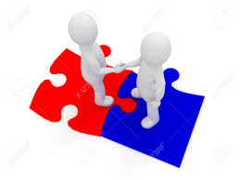
Enterprise Systems
Support the business processes of an organisation across any functional boundaries that exist within that organisation.
Use internet technology to connect the business with suppliers, customers and partners.
Main elements of Enterprise systems are ERP, CRM, SCM and SRM.
Customer Portal
Customer
Supplier Portal
Supplier
Authorized Access
Business Organization
Business partners

Slide 17
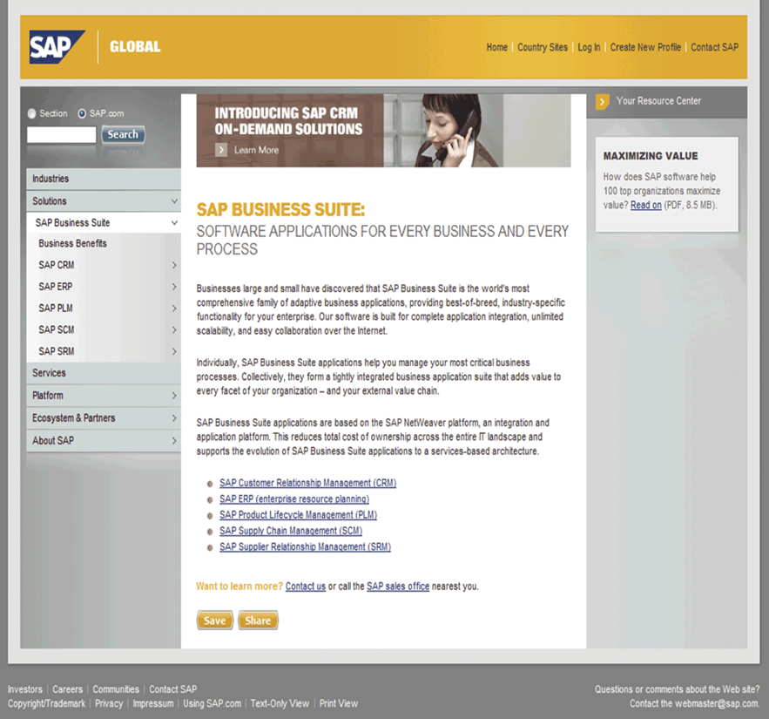
Enterprise Systems Cont.
Enterprise applications from SAP
Watch video on
SAP BUSINESS SUITE 7
RETAIL DEMO

Slide 18
Enterprise Systems Cont.
  Enterprise Resource Planning(ERP) Systems:
  ERP provides a single integrated solution from a single supplier for major business functions such as marketing, finance etc.
  Advantage of ERP is it removes ‘information islands’ (separate applications and data in different parts of the company).
  Disadvantages of ERP include high cost, major change required for implementation and need to change working methods to software.

Slide 19
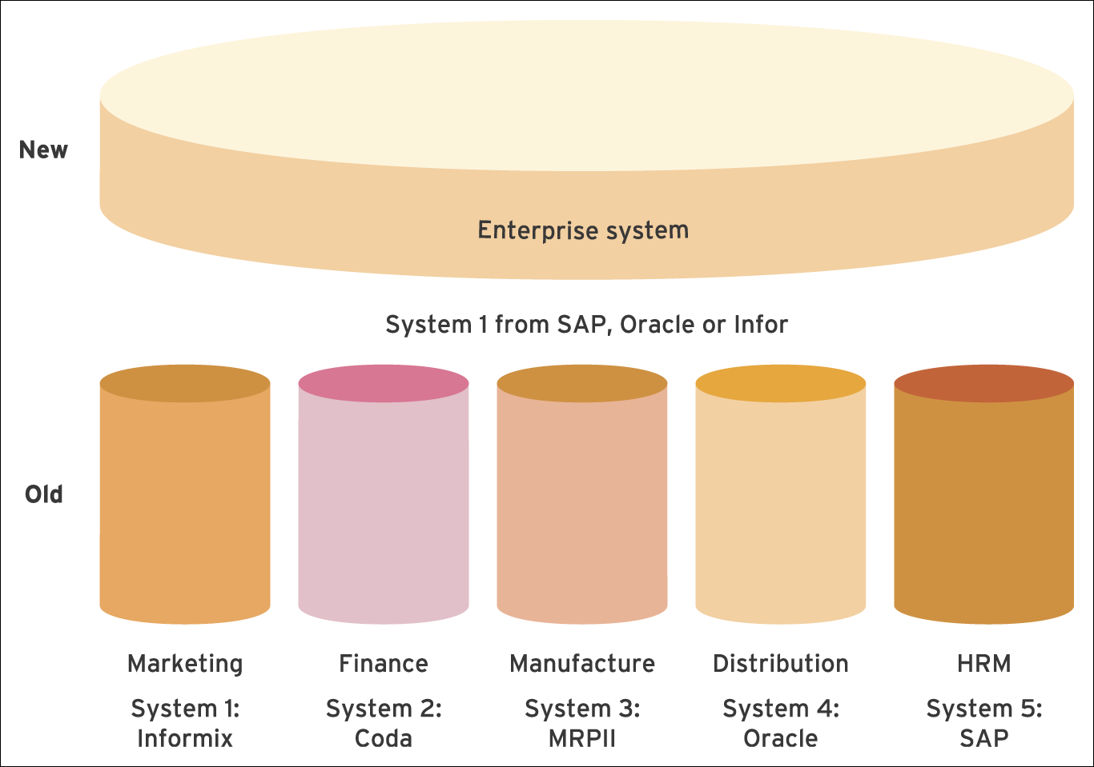
Enterprise Systems Cont.
ERP system in comparison to separate functional applications

Slide 20
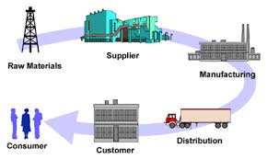
Enterprise Systems Cont.
  Supply Chain Management (SCM) Systems:
  A supply chain consists of the series of activities that moves materials from suppliers through the organisation to customers.
  Activities involves
    Warehouse Management,
    Logistics management,
    Transportation Management,
    Demand Forecasting,
    sales forecasting,
    Manufacturing planning and controlling,
    Marketing,
    Quality Planning,
    Financial Planning, …..
  Ex: QuickBase, SAP SCM, Infor SCM

Slide 21
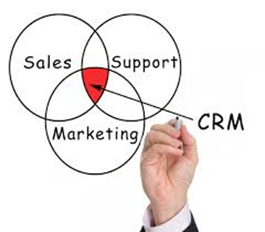

Enterprise Systems Cont.
Customer Relationship Management (CRM) Systems:
CRM systems analyze customer interactions and data throughout the customer lifecycle, with the goal of improving business relationships with customers, assisting in customer retention and driving sales growth.
Designed to integrate the range of
information systems that contain information
regarding the customer.
Also, It collects and compile customer data
through company's website, telephone, live chat, direct mail, marketing materials and social media.
CRM provides customers' personal information, purchase history, buying preferences and concerns. That enables giving individual attention to the customer.
Helps to know your Customer well and treats individually.

Slide 22

Enterprise Systems Cont.
Supplier Relationship Management (SRM) Systems
These systems refer to all the activities involved with obtaining items from a supplier, including procurement, transportation and warehousing.
Aim to streamline and make more effective the processes between an enterprise and its suppliers
Procurement is an important aspect of SRM as the cost of materials can represent a substantial amount of the total cost of a product or service.
Choosing a supplier is another important aspect of SRM.
SRM is a component of SCM information flow.
Lead to lower production costs and a higher quality,
but lower priced end product.
Popular Vendors:
  12 Technologies, Manugistics, PeopleSoft, SAP

Slide 23
E-Commerce Systems
What is E-Commerce?
E-commerce is usually associated with buying and selling over the Internet
or
Conducting any transaction involving the transfer of ownership or rights to use goods or services through a computer-mediated network
Thomas L. Mesenbourg, Measuring Electronic Business: Definitions, Underlying Concepts, and Measurement Plans

Slide 24
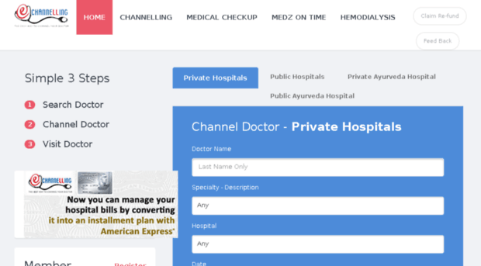


E-Commerce Systems Cont.
eCommerce Transaction
Service provider
Service consumer

Slide 25

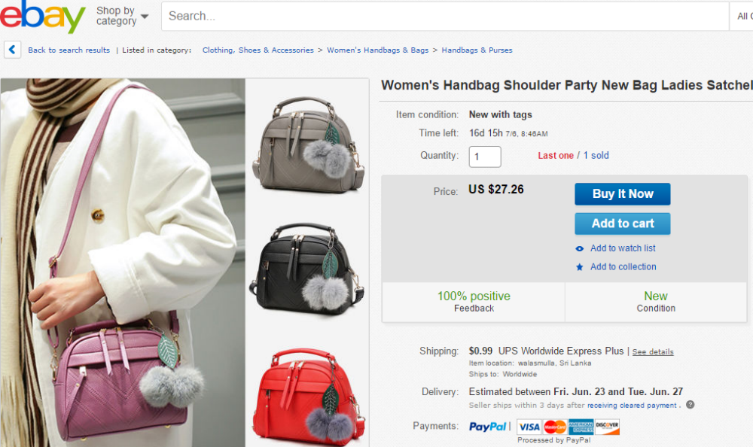

E-Commerce Systems Cont.
eCommerce Transaction
Service provider
Service consumer

Slide 26
Cloud based Systems
Cloud computing –
Provides availability of entire computing infrastructure (HW/SW) over the Internet.
Users purchase computing capacity on-demand (as need arises or decreases).
Free of Capital Expenditure, Staff and maintenance cost
Work from anywhere.
Cloud based backup and recovery solutions.
Any Information System can be converted in to a cloud based system.

Slide 27
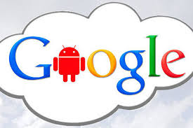

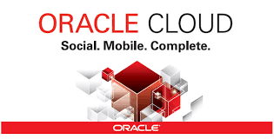

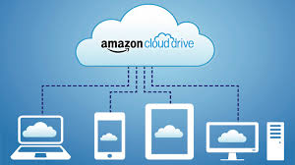
Cloud based Systems Cont.
Cloud Service Providers:
  Saleforce.com
  Google Cloud Platform (GCP)
  Oracle Cloud,
  Amazon Cloud Drive
  Microsoft Azure

Slide 28
Cloud based Systems Cont.
Popular Cloud based systems:
Systems that store, access data and programs (Infrastructure) over the cloud/internet.
Ex:
Oracle NetSuite - a complete cloud-based ERP solution on Oracle Cloud.
Office 365 – provides group of software and related services to subscribers such as email, OneDrive (Cloud storage) on MS Azure

Slide 29
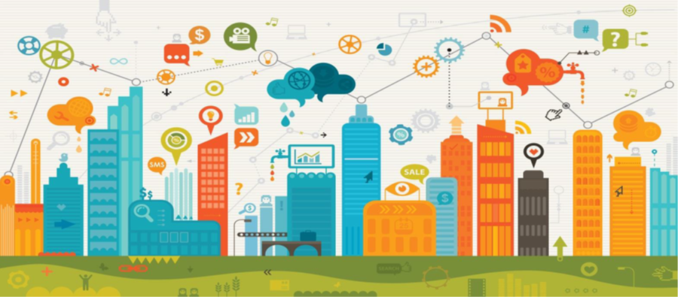
IoT (Internet of Things) Systems
IOT Concept:
The Internet of Things (IoT) is a network of objects each embedded with sensors(things) which are connected to the Internet.
This concept is connecting any device with an on and off switch to the Internet. This includes everything from mobiles, air conditioners, headphones, wearable devices and almost anything.

Slide 30
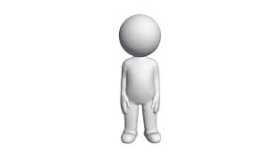
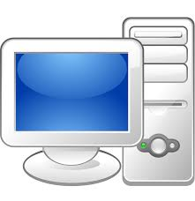
IoT (Internet of Things) Systems Cont.
Without IoT…
With IoT…

Slide 31
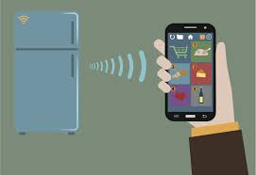

IoT (Internet of Things) Systems Cont.
IoT makes anything “SMART” enhancing every aspect of life with the power of data collection (through sensors), AI algorithms and networks.
Ex:
Sensors connected to your refrigerator and cabinets
detect when milk and your favorite cereal run low, then
automatically place an order with your preferred grocer.
Sensors such as heart rate monitors, blood pressure monitors, implant in your body, track you and when it breaches the risk level analyze and diagnose the critical condition, automatically send details to your doctor and the ambulance come to pick you to the hospital.
IoT systems have applications across industries through their unique flexibility and ability to be suitable in any environment.
Ex:
Transportation and logistics , Healthcare, Agriculture,
Smart environment (home, office, plant), Personal and social,
Energy and power

Slide 32
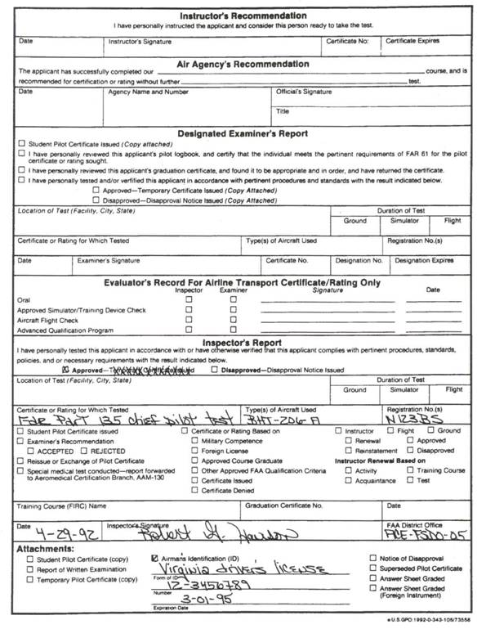
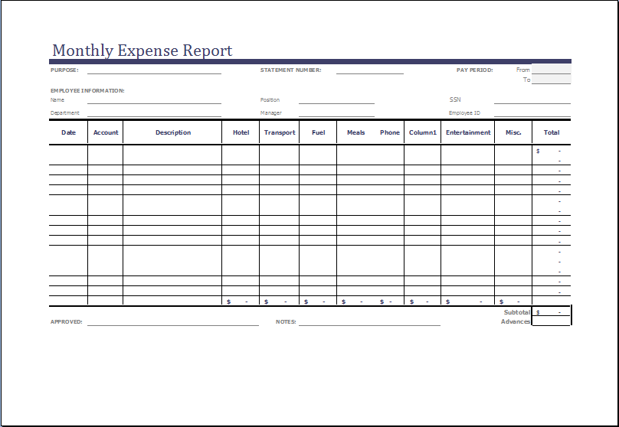
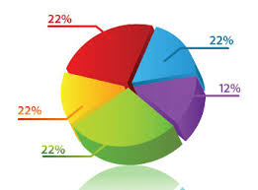
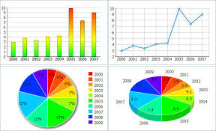
BI(Business Intelligence) Systems
Process
Information
Raw Data
meaningful and support
decision making
Ex: Reports with organized information
Facts
Ex: Data in an
Application form
Business Analytics
Intelligence/ Knowledge
more meaningful and predictable information to better decision making
(specially for strategic management for strategic planning)
Ex: Prediction on profitability of a product with existing and future market condition.
BI
Systems

Slide 33
BI(Business Intelligence) Systems Cont.
BI systems analyze/mine organizations raw data and Information to reveal insights of the business and build intelligence to help a business make faster and more accurate decisions.
BI systems uses techniques such as data mining, statistics, online analytical processing, querying and reporting.
Integrate data/information from across the enterprise. (Big Data).
Illustrates business intelligence in the areas of customer profiling, customer support, market research, market segmentation, product profitability, statistical analysis, inventory and distribution analysis, . . .

Slide 34
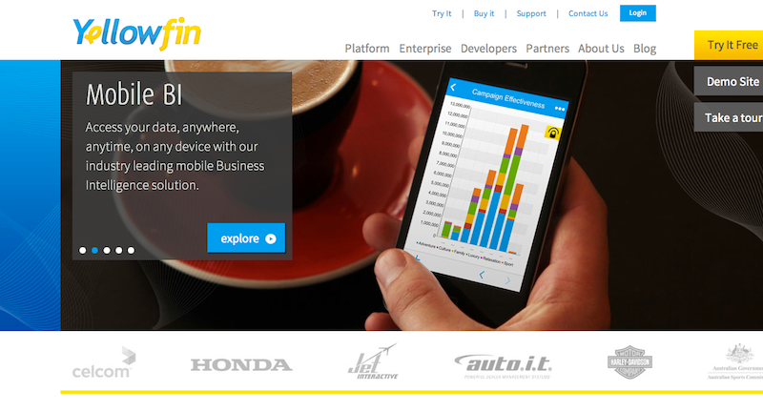
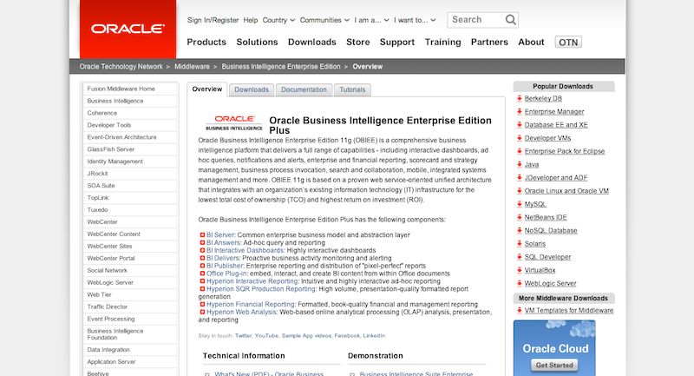
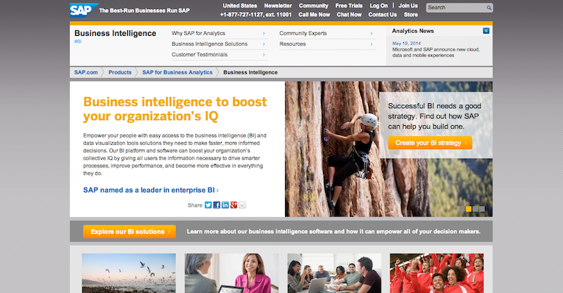
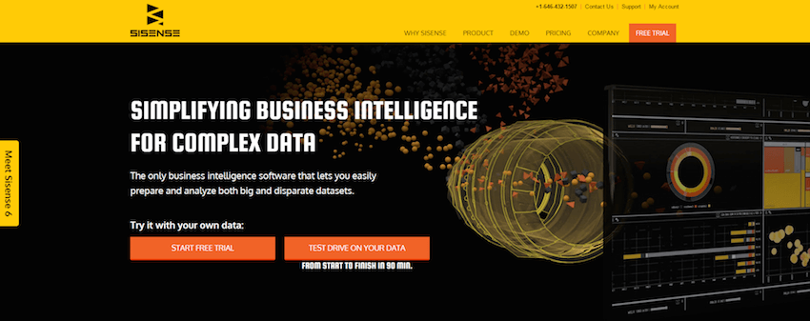
BI(Business Intelligence) Systems Cont.
Existing systems:
Yellowfin
Oracle Business Intelligence
Enterprise Edition OBIEE
http://www.oracle.com/technetwork/middleware/bi-enterprise-edition/overview/index.html?ssSourceSiteId=opn
https://www.yellowfinbi.com/
SAP Business Intelligence
SISENSE
https://www.sisense.com/
http://www.sap.com/pc/analytics/business-intelligence.html

Slide 35
Technologies behind Modern Information Systems
Internet (WWW)
Mobile Technology
Sensor networks
Global Positioning Systems (GPS)
Cloud Computing and Virtual environments
Object tracking technologies Ex. RFID(Radio Frequency IDentification) , NFC (Near Field Communication)
Wireless communication
Artificial Intelligence (AI)
Distributed storage – Ex. Hadoop
Payment gateways (Credit card payment)
Web Services

Slide 36
Data Management within Information Systems Context
Data is one of the important aspects of any kind of Information System.
Modeling and managing data is a fundamental requirement for a successful Information System.

Slide 37

Reference
K. C. Laudon and J.P. Laudon, “Management Information Systems: Managing the digital Firm”, INFORMATION SYSTEMS IN BUSINESS TODAY, 13th Ed, 2014

Slide 38
Learning Outcomes
LO2: Evaluate the information systems strategies to achieve organizational goals

Slide 39
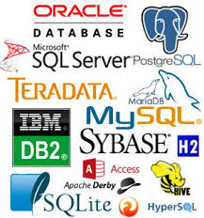
Next Lecture
Data Modeling
(Introduction to Database and DBMS)

Slide 40

End of Lecture 03

